Slide 1
Research on 3D Object Detection based on Deep Learning
九州工業大学
学生番号： 205F2002
学生氏名： YANG Shuo
2020.12.23
Notes:
Good afternoon, my dear professors and classmates. This is my research topic that 3D Object Detection based on Deep Learning.

Slide 2
Contents
Background
Related Work
Purpose of the research
Proposed methods
Details of algorithms
Originality of the proposed methods
Flowchart
Experimental results
Discussions
Conclusion and Further Work
Notes:
Now, This is the content for my report, it includes 7 parts

Slide 3
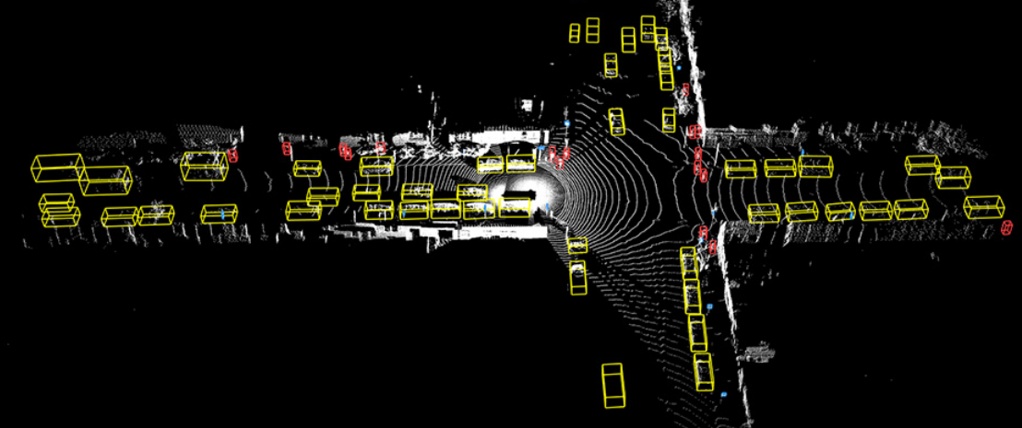
Background
3D object detection is the basic task and technology for autonomous driving;
It is a key problems that using point cloud data to detect 3D object;
How to use the deep learning-based detection method to achieve the application.
Notes:
For the background of our topic.
Firstly, 3D object detection is a basic project and technology for the autonomous driving scenes.
Second, most of method use the large number of data to finish the detection task, such as 2D image, RGB-D data and so on. Recently, with the universal applications of LiDAR cameras, point cloud data become the important research data which include the depth and geometric space information of the object. In our work, we want to use the point cloud to achieve the higher accuracy detection of 3D object.
Third, deep learning-based method has a good information on the task of computer vision. But we need to consider the model of memory and running rate for this method. It is a significant problem that we want to apply the method in the actual production.

Slide 4
Related Work
3D Object Detection
Two-stage
Methods
Multi-view Methods
Point Learning Methods
Single-stage Methods
3D YOLO Methods
Voxel Convolution Methods
Detection Head
Notes:
Related work.
According to the detection framework or head, we can divide the 3D object detection into two kinds: two-stage methods and single-stage methods. The standards are similar to the 2D object detection. At present, many method frameworks of 3d detection comes from the two-stage method of 2D object.

Slide 5
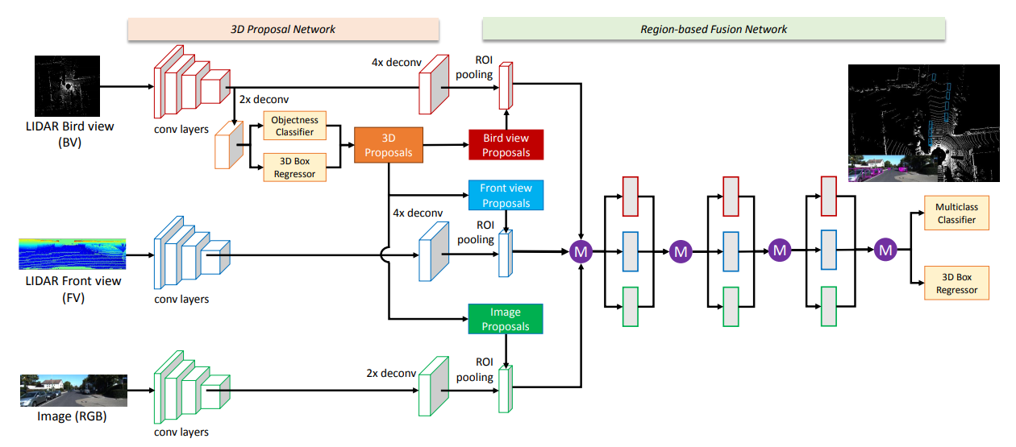
Related Work
Two-stage
Methods
(1）Using point cloud to generate Bird’s-Eye View and Front View [1]
(2) Using convolution to generate the region proposals
(3) Feature refinement, classification and box regression
[1] Chen, Xiaozhi，Ma, Huimin, Wan Ji, et al. Multi-View 3D Object Detection Network for Autonomous Driving. IEEE Conference on Computer Vision and Pattern Recognition (CVPR). (2017).
Notes:
For the details of this method.
Two stage methods need to calculate twice classification and twice box regression.
The first classification and regression need to distinguish the foreground and background on the region proposals.
The second classification and regression fuse the region proposals and raw feature map to acquire a higher accuracy result.
For this method, it needs to use the point cloud to complete the feature extraction.

Slide 6
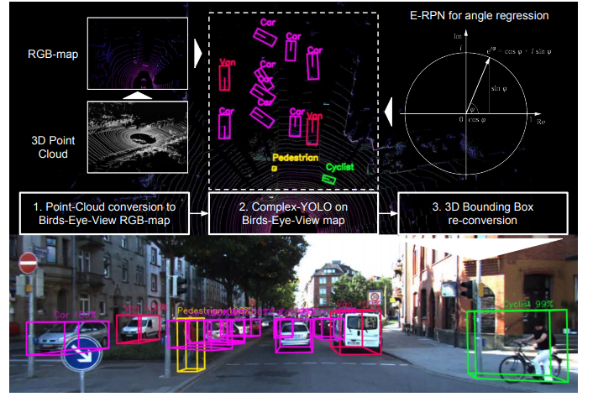
Related Work
Single-stage Methods
(1）Data Conversion [2]
(2) 2D Bounding Box Prediction
(3) 3D Bounding Box re-conversion
[2] Martin Simon, Stefan Milz, Karl Amende, Horst-Michael Gross. Complex-YOLO: An Euler-Region-Proposal for Real-time 3D Object Detection on Point Clouds. 2018
Notes:
For the single-stage method, it uses the conversion function for point cloud data to generate the 2D RGB map. Then, it uses 2D detection method to predict 2D bounding box and classification. At last, according to the conversion function, this method can acquire the 3D bounding box.

Slide 7
Related Work
Two-stage
Methods
Tedious data processing
Large amount of calculation
Single-stage Methods
Poor representational ability
Lower detection precision
Notes:
In summary, we analyzed these methods problem.
For the two-stage method, the data processing of the current method is complicated, such as multi-view images. And this method requires a large number of calculations.
For the single-stage method, it is affected by the feature extraction, which lead to lose the space feature of three dimensional. Meanwhile, limited calculation cannot have a good result.

Slide 8
Purpose of the research
A unified framework could integrate the method of 3D convolutional neural networks and point learning to improve the feature extraction for point data.
Balancing between detection accuracy and speed by improving detection head.
Notes:
Thus, we propose our research task. Firstly, for the point cloud features, we want to design a unified framework and combine the convolutional features and point features. Second, we hope to increase detection speed on the basis of ensuring the detection accuracy. Now, we first explore the improved method on the accuracy.

Slide 9
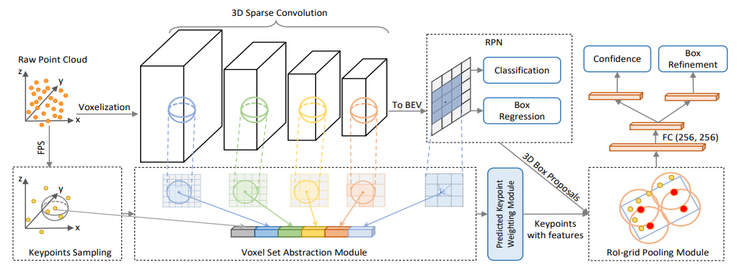
Proposed methods
Point-Voxel Region Convolutional Neural Network(PV-RCNN)[3]
(1）3D Sparse Convolution and Region Proposals Networks (RPN)
(2) Voxel Set Abstraction Module
(3) ROI(Region of Interset)-grid Pooling Module
[3] Shaoshuai Shi, Chaoxu Guo, Li Jiang. PV-RCNN: Point-Voxel Feature Set Abstraction for 3D Object Detection. IEEE International Conference on Computer Vision and Pattern Recognition (CVPR). (2020).
Notes:
At present, we are working on this method, called PV-RCNN.
It is a typical two-stage method for the 3D object detection. This method contains three parts.
At first, 3D Sparse Convolution and Region Proposals Networks use the convolutional features to generate the candidate region proposals for the object, and it need to complete the foreground and background for the region proposals. Second, Voxel Set Abstraction Module acquires the keypoint features by keypoint sampling. Third, ROI pooling fuse keypoint features into region proposals and complete the classification and box regression.

Slide 10
Details of algorithms
（1）3D Sparse Convolution and Region Proposals Networks (RPN)：
Voxelization for point cloud data;
Down-sampling of 3D convolution;
Generate Bird’s-Eye View to give the region proposals;
Classification and box regression
Notes:
This is the details method for 3D Sparse Convolution and Region Proposals Networks.
For the voxelization of point cloud, we can get the space matrix for the 3D images. Then, we can use the 3D convolution to extract the features.
Next, the feature map needs to generate the region proposals on the Bird’s eye view.
The first classification and regression will divide the foreground and background regions and delete the background region proposals.

Slide 11
Details of algorithms
（2） Voxel Set Abstraction Module ：
Furthest Point-Sampling (FPS) for point cloud data;
Keypoints sampling for different layers ;
Generate keypoint with features
Notes:
For the first part, this method think it lose a lot of features in down-sampling. So, the second part aim at extracting the keypoint features to add the information. Its name is Voxel Set Abstraction Module.
It uses the method of Furthest Point-Sampling to progress the point cloud.
Then, this is the keypoints sampling. And this method needs to complete keypoints sampling for different layers in the 3d sparse convolution.
At last, the output is keypoints with features

Slide 12
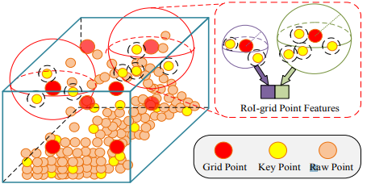
Details of algorithms
（3） ROI(Region of Interset)-grid Pooling Module：
Input：Region proposals and keypoints with features；
Feature fusion for every region proposals；
Classification and box refinement
Notes:
The third part is ROI-grid Pooling Module.
The input data is Region proposals from the first part and keypoints with feature from the second part.
This is the region proposals of grid. For every grid, it will fuse the keypoints feature to generate the new identical size regions. For the regions proposals, we need to compute the second classification and box regression.

Slide 13
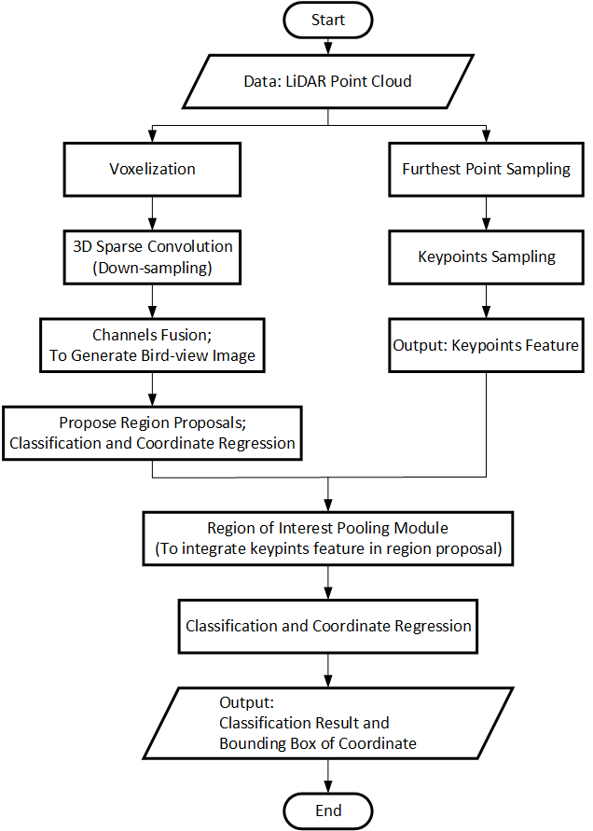
Flowchart
Convolutional feature extraction
Point sampling
Feature fusion
Classification and box regression
Notes:
This is the flowchart for this method. The input data is Lidar point cloud. We can divide the processing into two stage. it will propose the region proposals according to Convolutional features extraction. Keypoint features sampling. The ROI module fuse the Keypoint features into region proposals and complete the classification and box regression.

Slide 14
Originality of the proposed methods
Using the LiDAR point cloud data （It has more refined feature）
The method of feature extraction: Combining 3D spares convolutional neural network with keypoints sampling
Notes:
The Originality of the proposed methods.
Firstly, this method only uses the LiDAR point cloud data to train the model.
Then, it can combine the convolution networks with keypoints sampling to extract the object features.
At last, it uses the two-stage detection method to predict the classes and bounding box. The detection framework is faster R-CNN.

Slide 15
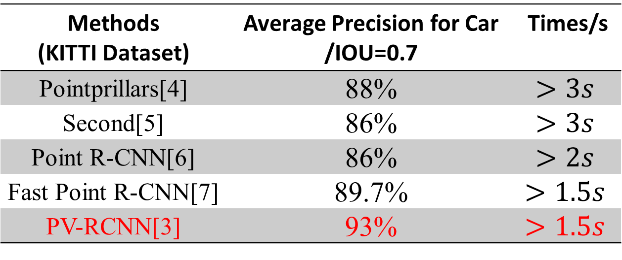
Experimental results
Compare the detection accuracy and times.
KITTI 3D Dataset: 3 classes, 15000 images，Test-set 3691 images
The environment of experiments: 12GB RTX2080 Ti
Table 1 Result of KITTI 3D Object Detection Dataset
Methods (KITTI Dataset) | Average Precision for Car /IOU=0.7 | Times/s
Pointprillars[4] | 88% | $$>3s$$
Second[5] | 86% | $$>3s$$
Point R-CNN[6] | 86% | $$>2s$$
Fast Point R-CNN[7] | 89.7% | $$>1.5s$$
PV-RCNN[3] | 93% | $$>1.5s$$
[3] Shaoshuai Shi, Chaoxu Guo, Li Jiang. PV-RCNN: Point-Voxel Feature Set Abstraction for 3D Object Detection. CVPR2020.
[4] Alex H. Lang, Sourabh Vora, Holger Caesar, et al. PointPillars: Fast Encoders for Object Detection from Point Clouds. CVPR2019.
[5] Yan Yan, Yuxing Mao, Bo Li. SECOND: Sparsely Embedded Convolutional Detection. Sensors 2018.
[6] Shaoshuai Shi, Xiaogang Wang, Hongsheng Li. PointRCNN: 3D Object Proposal Generation and Detection from Point Cloud. CVPR2019.
[7] Yilun Chen, Shu Liu, Xiaoyong Shen, et al. Fast Point R-CNN. ICCV2019.
Notes:
We also evaluate the method On the Dataset of KITTI 3D with our experimental environment. Meanwhile, we select 4 method as comparison method. The result come from the best model of our optimized parameters. You can see, Pv-RCNN has the best performance in the loadboard compared with other method. But, for the two-stage method, it still needs to improve the speed

Slide 16
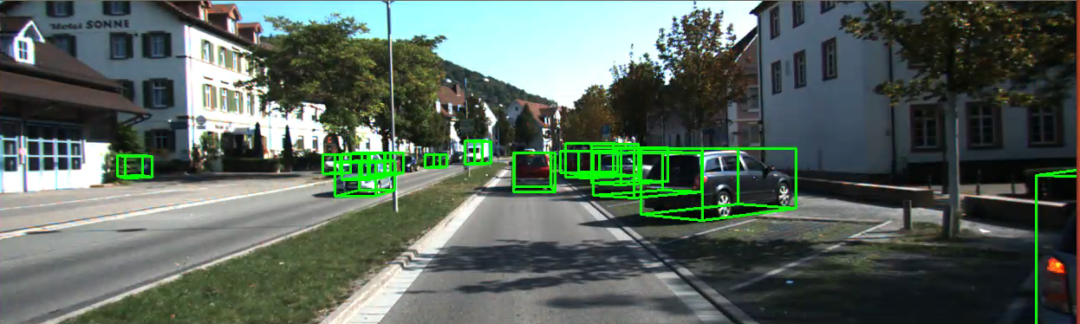
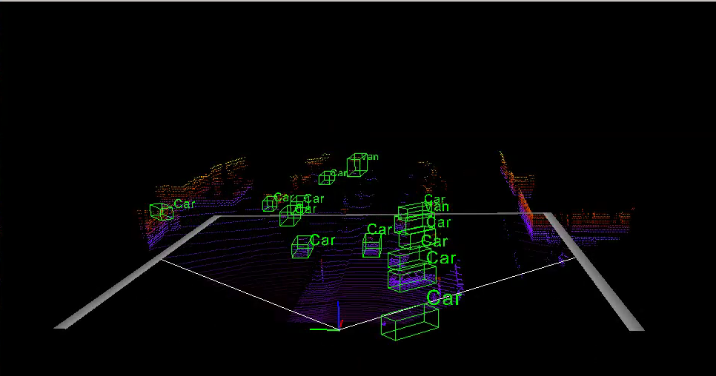
Experimental results
Notes:
This is the actual detection result on the kitti dataset.

Slide 17
Discussions
Convolutional network of the down-sampling makes it difficult to extract great features for small sizes objects.
Lower detection speed
Notes:
First, compared with the 2D detection method, this method uses the down-sampling feature map to predict the object which cannot acquire a good performance for the location.
Meanwhile, the raw point cloud is sparsity, the convolution will lose more features for the object.
Second，the two-stage method need a large amount of calculation.
Thus, this method is difficult to apply to lightweight devices.

Slide 18
Conclusion and Further Work
1.For the backbone, we want to use the feature fusion of cross-layers to improve representational ability of networks
2.For the feature refinement of point cloud, we plan to use the learning method instead of keypoints sampling.
3.For the detection head, we need to reduce the amount of classification and box regression to achieve the application on the lightweight devices.
18
Notes:
For the problem, I have three ideas for solving the problem. This is my future work.
Firstly, for the backbone of feature extraction network, I want to use the feature fusion method to improve representational ability of networks, such as adding the up-sampling convolution or deconvolutional neural networks. Second, I plan to use the learning method instead of keypoints sampling. In my opinion, learning based method can acquire the fine-graind features for the point cloud. Third, we want to reduce the steps of box regression and classification calculation. Such as we can use the once classification and once box regression to complete the detection framework.

Slide 19
ご清聴ありがとうございました。 Thank you.

